Slide 1
Artificial Intelligence
First Order Logic

Slide 2
Limitation of Propositional Logic
The facts:
  “peter is a man”, “paul is a man”, “john is a man” can be symbolized by P, Q and R respectively in propositional logic,
Can’t draw any conclusions about similarities between P, Q and R.
Better to represent these facts as – MAN(peter), MAN(paul) and MAN(john).
Even more difficult to represent sentences like “All men are mortal” in propositional logic.
– Such sentences really need quantification.
In Predicate Logic, these limitations are removed to great extent.

Slide 3
First-order logic (FOL)
While propositional logic assumes the world contains facts, that are true or false.
First-order logic assumes the world contains:
  Objects: referred using noun phrases e.g. people, houses, numbers, colors, baseball games, wars, …
  Relations between objects: referred using verb phrases e.g. red, round, prime, brother of, bigger than, part of, comes between, …
Some relations are properties: they state some fact about a single object:
  round(ball), prime(7).
Relations also state facts about two objects:
  married(john,mary), largerthan(3,2).
Some relations are functions: their value is another object:
  plus(2,3), father(dan).

Slide 4
FOL Examples
  “One plus two equals three.”
  Objects: one, two, three;
  Function: plus. (“One plus two” is a name for the object that is obtained by applying the function “plus” to the objects “one” and
  “two.”
  Relation: equals; equals( plus(one, two), three )
  “Squares neighboring the wumpus are smelly.”
  Objects: wumpus, squares;
  Property: smelly; Smelly(x)
  Relation: neighboring. Neighbor(x, wumpus) → Smelly(x)
  “Evil King John ruled England in 1200.”
  Objects: John, England, 1200;
  Relation: ruled; ruled(john, england, 1200)
  Properties: evil, king evil(john), king(john)

Slide 5
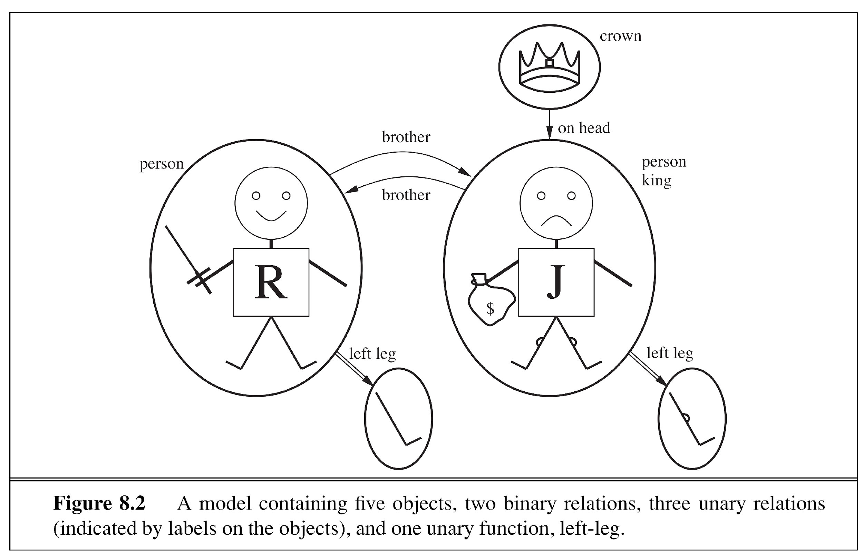
Objects, Relations and Functions
Identify objects, relations and functions in the following model.

Slide 6
Objects, Relations, Functions
Objects:
  Richard
  John
  Richard’s Left Leg,
  John’s Left Leg
  Crown
Relations:
  Brothers (Richard, John )
  onhead(Crown, John)
  Properties
    Person (Richard)
    King (John)
    Crown(Crown)
Functions:
  LeftLeg(John)
  LeftLeg(Richard)

Slide 7
Atomic Sentences
We can combine objects and predicate symbols (relation/property) to make atomic sentences that state facts.
An atomic sentence (or atom for short) is formed from a predicate symbol optionally followed by a parenthesized list of terms, such as
  Brother(Richard,John).
An atomic sentence is true in a given model if the relation referred to by the predicate symbol holds among the objects referred to by the arguments.
  LargerThan(2,3) (means 2>3) is false.
  Brother(Richard, John) is true.
We usually follow the argument-ordering convention that is read as “ x is a P of y”.
For example. Married(Father(Richard), Mother(John)) states that Richard the Lionheart’s father is married to King John’s mother.

Slide 8
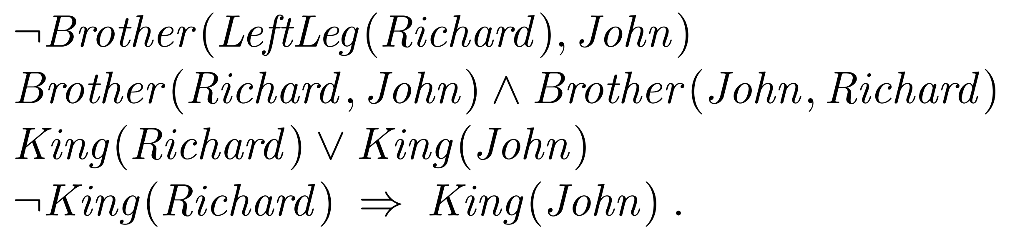
Complex Sentences
Complex sentences are made from atomic sentences using connectives.
  ¬S, S1 ∧ S2, S1 ∨ S2, S1 ⇒ S2, S1 ⇔ S2
  For Example,
  sibling(kingJohn, richard) ⇒ sibling(richard, kingJohn)

Slide 9
Complex Sentences
We make complex sentences with connectives (just like in propositional logic).
property
binary
relation
function
objects
connectives

Slide 10


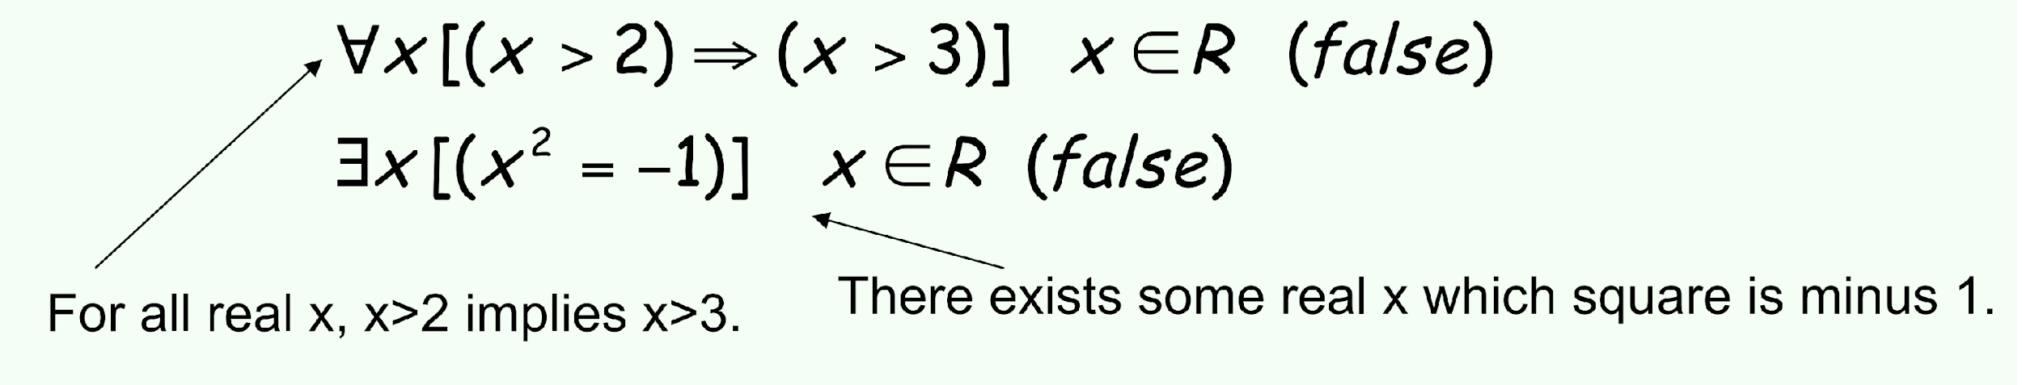
Quantification
round(ball) is true or false because we give it a single argument (ball).
We can be much more flexible if we allow variables which can take on values in a domain. e.g. X, Y, Z etc.
To construct logical sentences we need a quantifier to make it true or false.
Is the following true or false?
To make it true or false we use

Slide 11
Universal Quantification ∀
∀ means “for all”
Allows us to make statements about all objects in the domain of discourse that have certain properties
Can now state general rules:
  ∀ x king(x) => person(x)
  ∀ x person(x) => hasHead(x)
  i integer(i) => integer(plus(i,1))
  Note that
  x king(x) ∧ person(x) is not correct!
  This would imply that all objects x are Kings and are People
  ∀ x king(x) => person(x) is the correct way to say this

Slide 12
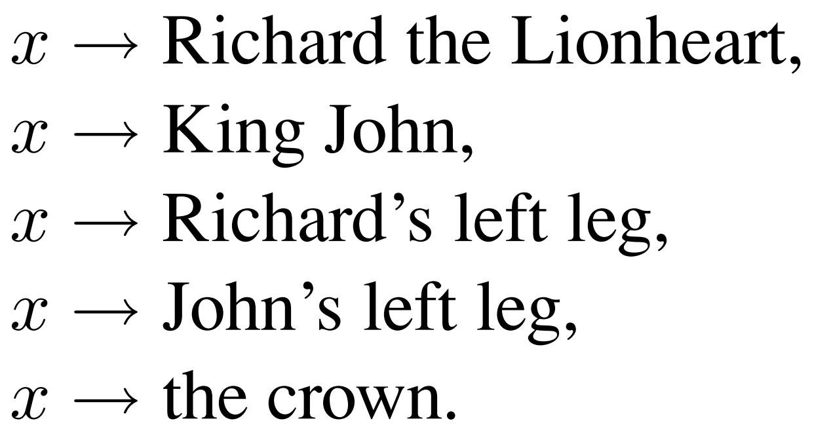
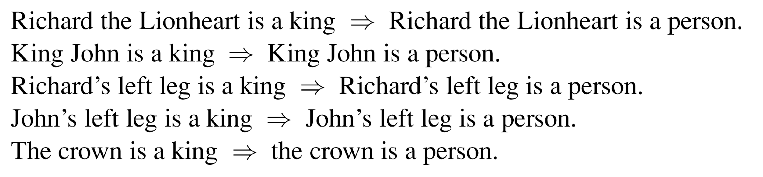
Why to use IMPLIES connective with universal Quantification
For example the sentence states:
  ∀ x king(x) => person(x)
It should be true for all values of x
Looking at the truth table of => states that it would be true when both premises are true or when premise of the sentence is false, so the => is a perfect symbol to be used with universal quantification.

Slide 13
Existential Quantification ∃
∃ x means “there exists an x such that….” (at least one object x)
Allows us to make statements about some object without naming it.
Examples:
  ∃ x King(x)
  ∃ x Lives_in(John, Castle(x))
  ∃ i Integer(i) ∧ GreaterThan(i,0)
  Note that ∧ is the natural connective to use with ∃
  and => is the natural connective to use with ∀

Slide 14
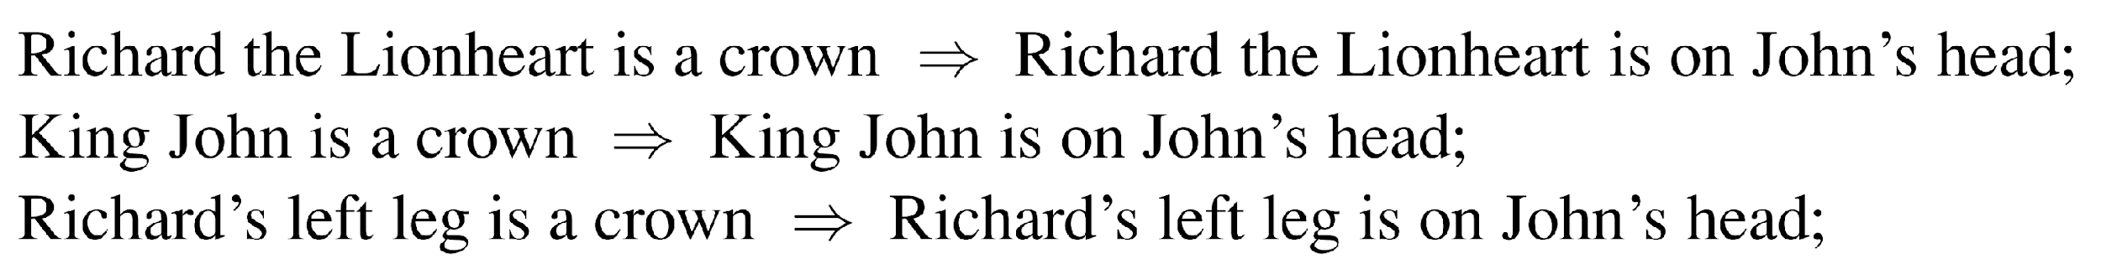
Why to use AND connective with Existential Quantification
For example the sentence states:
For above statement to be true, at least one of the statements should be true.
An implication is true even if the premise is false. So if Richard the Lionheart is not a crown, even then the first assertion is true and the existential is satisfied. So, an existentially quantified implication sentence is also true whenever any object fails to satisfy the premise; hence such sentences really do not say much at all. So AND appears to be the more natural connective used with existential quantifier.

Slide 15
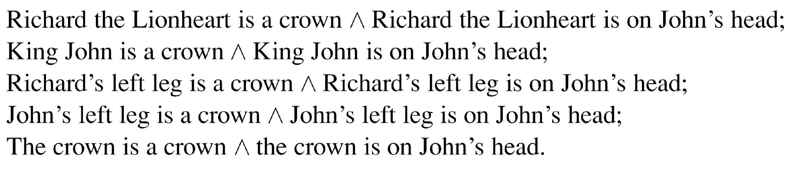
Why to use AND connective with Existential Quantification

Slide 16
Syntax of FOL: Basic elements
Constants kingjohn, 2, uci,...
Predicates brother,...
Functions Sqrt, ...
Variables x, y, a, b,...
Connectives ¬, ⇒, ∧, ∨, ⇔
Quantifiers ∀, ∃

Slide 17
Nested Quantifiers
Nested quantifiers occur when you have more than one quantifier in a formula, and one is inside the scope of another.
Simplest case is where the quantifiers are of the same type.
  Brothers are siblings
    ∀ x ∀ y Brother(x, y) ⇒ Sibling(x, y) .
We will have mixtures, for example,
  Everyone loves someone
    ∀x. ∃y. loves(x,y)
  There is someone who is loved by everyone
    ∃y. ∀x. loves(x,y)

Slide 18
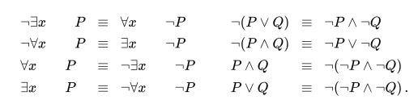
De Morgan’s Law
Because universal quantifier is really a conjunction over the universe of objects and existential quantifier is a disjunction, it should not be surprising that they obey De Morgan’s rules.
The De Morgan rules for quantified and unquantified sentences are as follows:

Slide 19
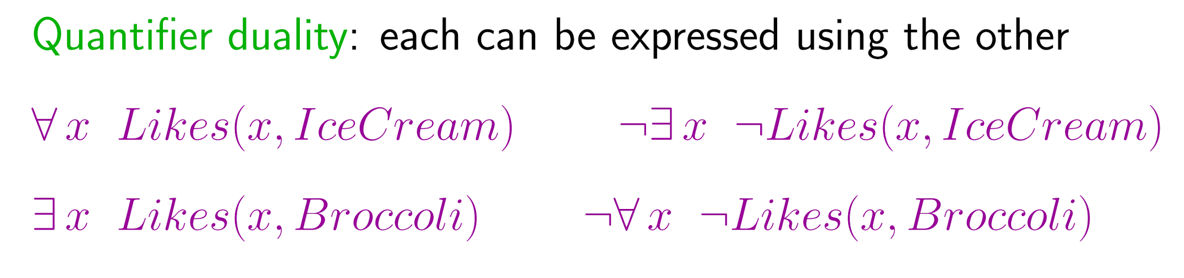
Quantifier Duality
Quantifier duality is a logical principle that relates universal (∀) and existential (∃) quantifiers through negation. You can rewrite one quantifier in terms of the other using ¬ (negation)
Asserting that everyone dislikes parsnips is the same as asserting there does not exist someone who likes them, and vice versa:
“Everyone likes ice cream” means that there is no one who does not like ice cream:

Slide 20
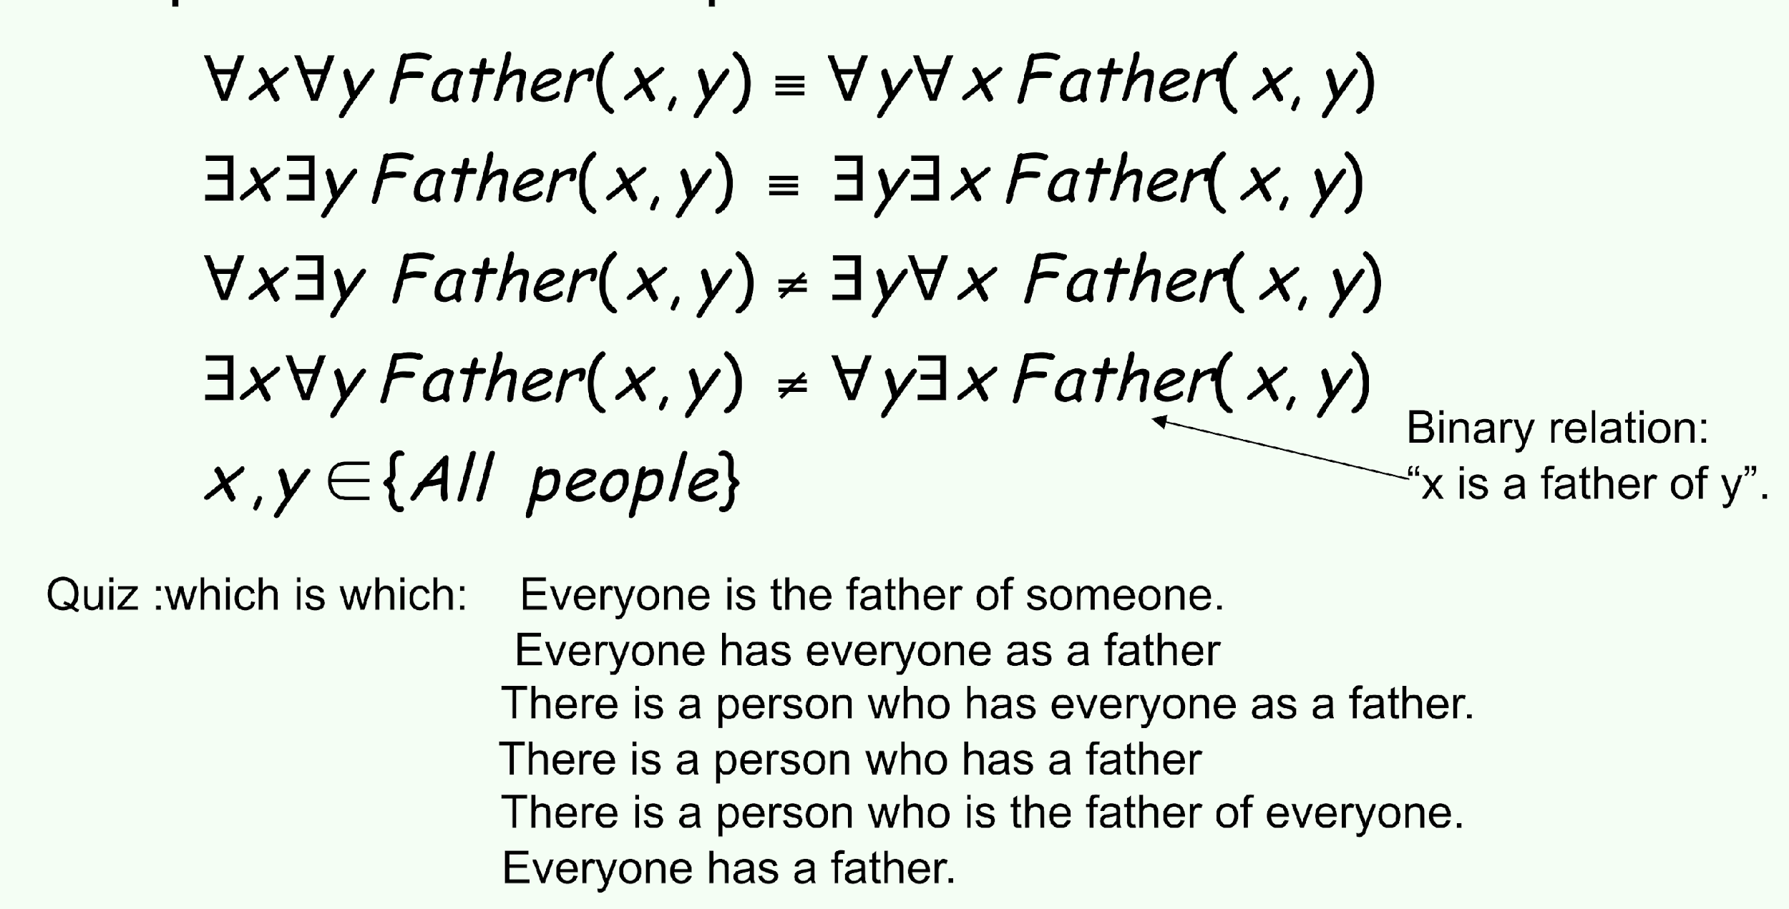
Nested Quantifiers

Slide 21
FOL Translation
"∀x∃yFather(x,y)",
  Everyone is the father of someone.
"∀x∀yFather(x,y)",
  Everyone has everyone as a father.
"∃y∀xFather(x,y)",
  There is a person who has everyone as a father.
"∃y∃xFather(x,y)","
  There is a person who has a father. (i.e., There exists a father-child relationship.)"
"∃x∀yFather(x,y)",
  There is a person who is the father of everyone.
"∀y∃xFather(x,y)",
  Everyone has a father.

Slide 22
Writing FOL
  Jane is a tall surveyor
  tall(jane) ˄ surveyor(jane)
Cats are mammals
  ∀ x cat(x) → mammal(x)
  Everybody has a father
    ∀ x. ∃ y. father(y,x)
  Everybody has a father and a mother
    ∀ x. ∃ yz. father(y,x) ˄ mother(z,x)

Slide 23
Writing FOL
Translate following sentences into First Order Logic
  Lucy is a professor
  All professors are people.
  Fuchs is the dean.
  Deans are professors.
  Everyone is a friend of someone.
  Lucy criticized Fuchs.

Slide 24
Writing FOL
is-prof(lucy)
ꓯx ( is-prof(x) → is-person(x) )
is-dean(fuchs)
ꓯx (is-dean(x) → is-prof(x))
ꓯx ∃ y (is-friend-of (x, y))
criticize(lucy,fuchs)

Slide 25
Exercise.
Translate the following sentences into First Order Logic.
  Every gardener likes the sun.
  You can fool some of the people all of the time.
  You can fool all of the people some of the time.
  All purple mushrooms are poisonous.
  No purple mushroom is poisonous.

Slide 26
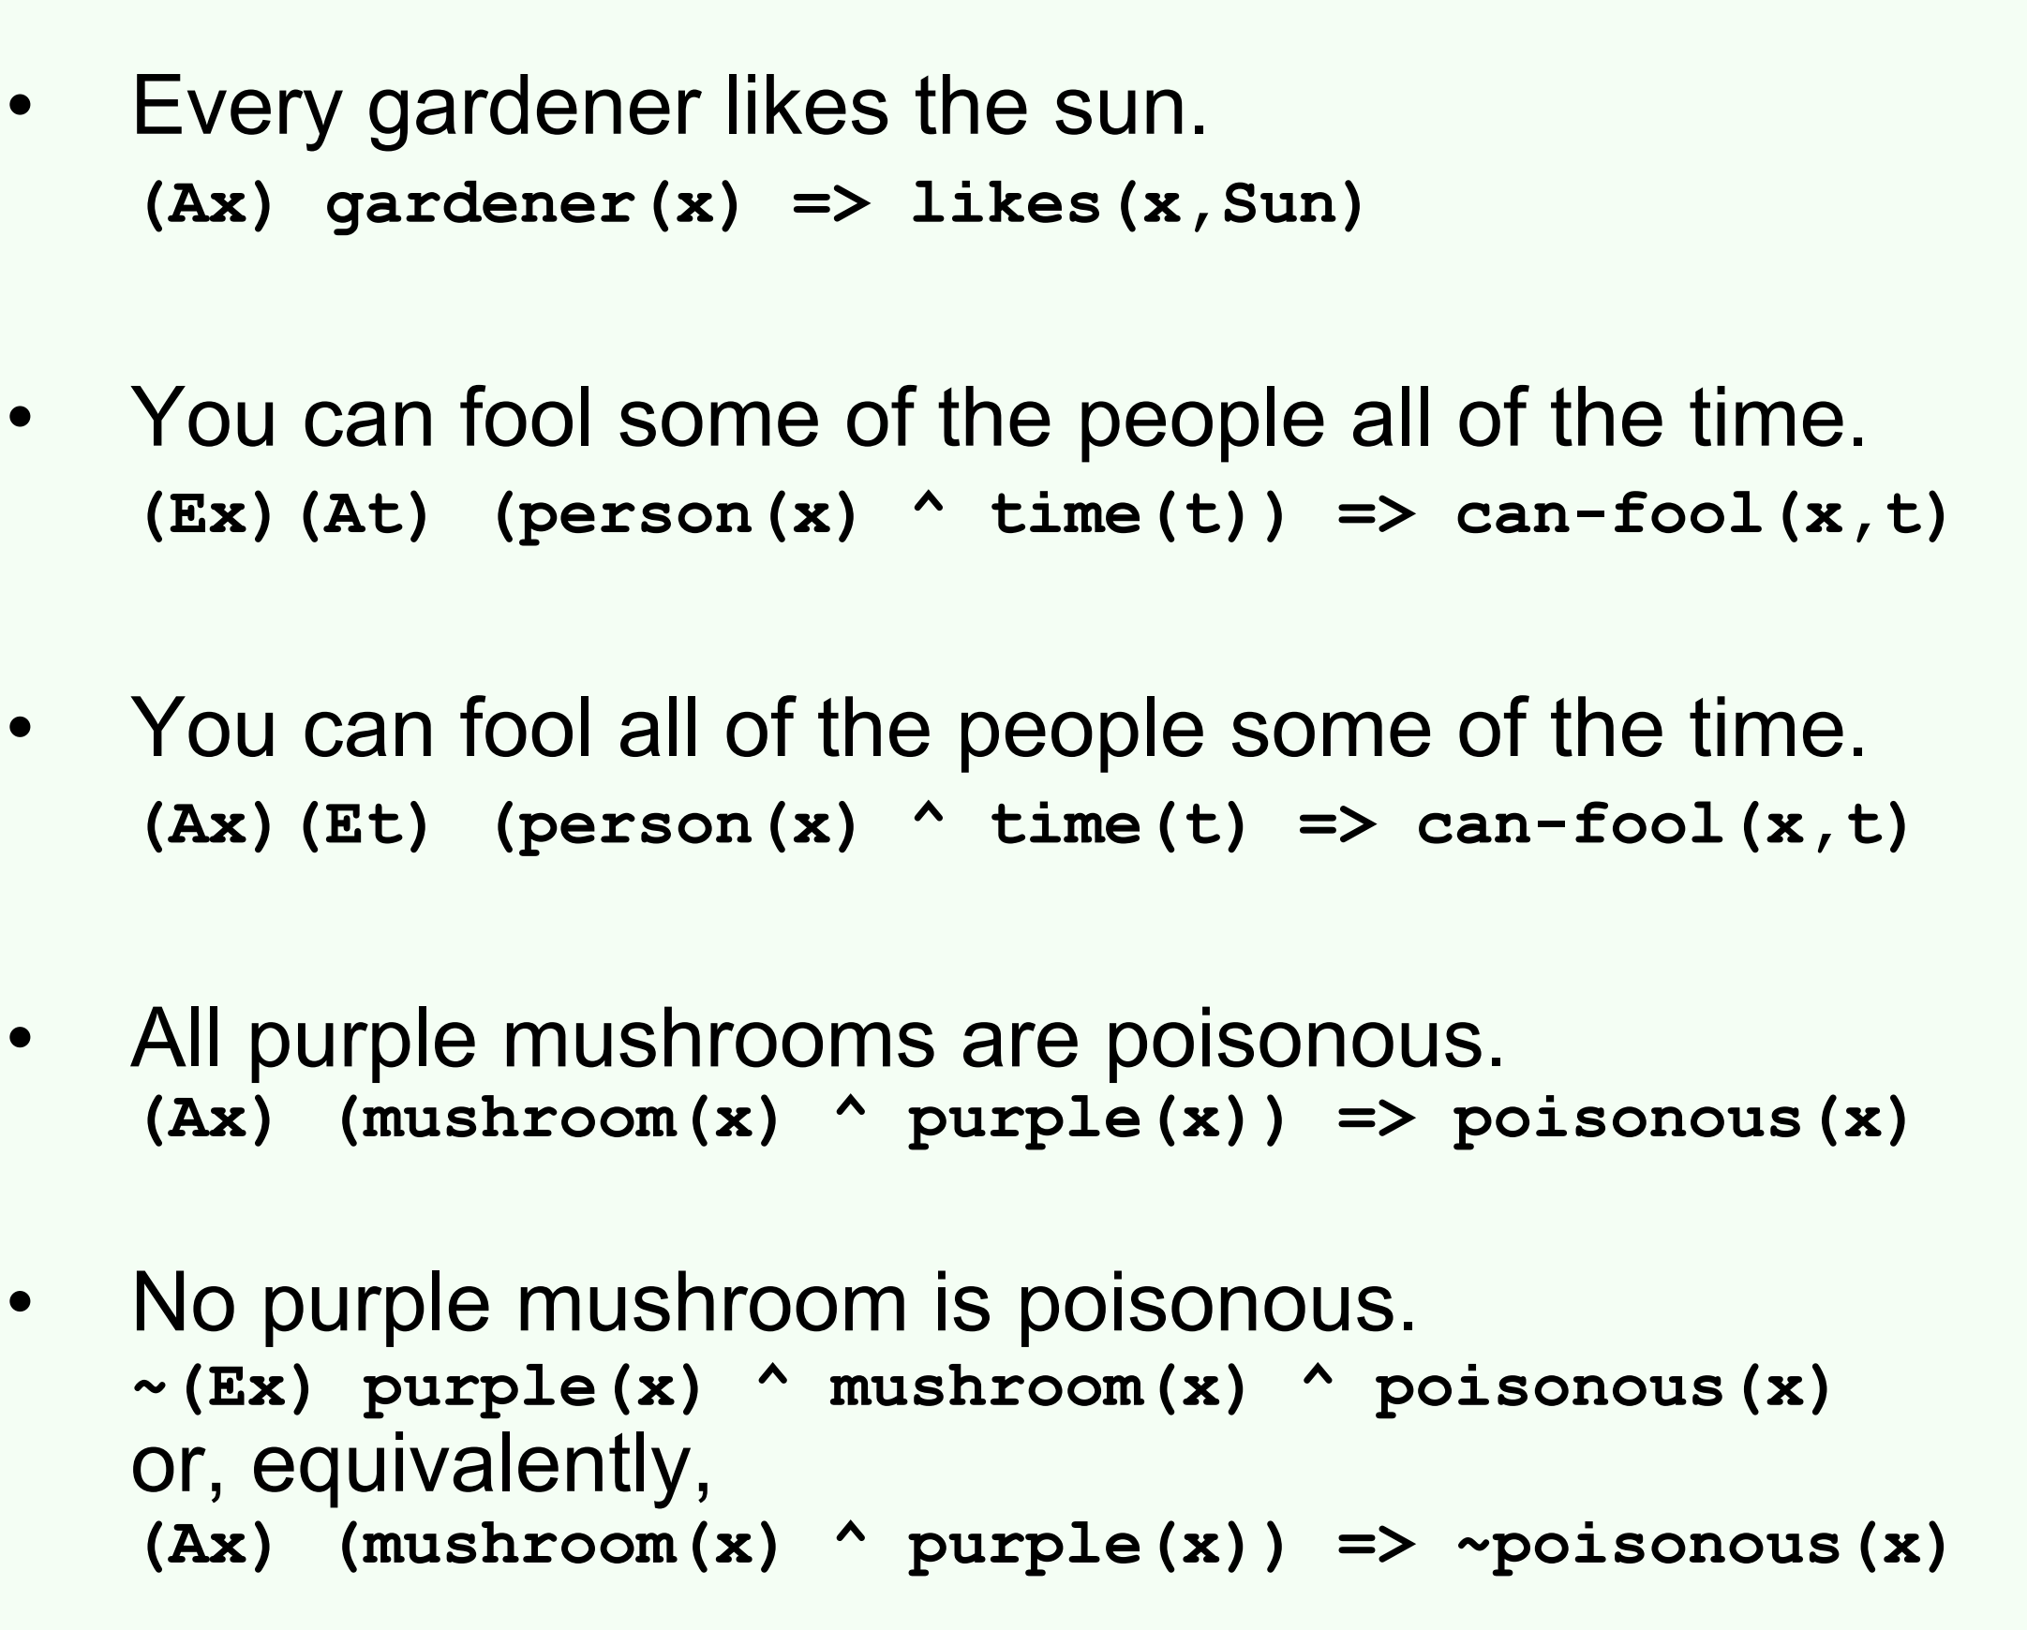
Solution

Slide 27
FOL Rules of Inference

Slide 28
Universal Instantiation (UI)
The rule of Universal Instantiation (UI) states that we can infer any sentence obtained by substituting the ground term (a term without variables) for the variable.
To write out the inference rule formally, we use the notion of substitutions. Let SubSt(θ, α) denote the result of applying the substitution θ to the sentence α. Then the rule is written: ∀v α
Subst({v/g}, α)
for any variable v and ground term. For example, the three sentences given earlier are obtained with the substitutions {x/John}, {x/Richard}, and {x/Father(John)}.
g
E.g., ∀x King(x) ∧ Greedy(x) ⇒ Evil(x) yields:
  King(John) ∧ Greedy(John) ⇒ Evil(John)
  King(Richard) ∧ Greedy(Richard) ⇒ Evil(Richard)
  King(Father(John)) ∧ Greedy(Father(John)) ⇒ Evil(Father(John))
  .
  .

Slide 29
Existential instantiation (EI)
In the rule for Existential Instantiation, the variable is replaced by a single new constant symbol.
For any sentence α, variable v, and constant symbol k that does not appear elsewhere in the knowledge base:
∃v α
Subst({v/k}, α)
E.g., ∃x Crown(x) ∧ OnHead(x,John) yields:
Crown(C₁) ∧ OnHead(C₁,John)
provided C₁ is a new constant symbol, called a Skolem constant. Existential Instantiation is a special case of a more general process called Skolemization.

Slide 30
Unification
Unification is the process of finding all legal substitutions.
We can get the inference immediately if we can find a substitution θ such that King(x) and Greedy(John) match King(John) and Greedy(y)
θ = {x/John,y/John}
∀x,y,z ((parent(x,y) ∧ parent(y,z)) ⇒ grandparent(x,z))
parent(james, john), parent(james, richard), parent(harry, james)
We can derive:
  Grandparent(harry, john), bindings:
  {x/harry,y/james,z/john}
  Grandparent(harry, richard), bindings:
  {x/harry,y/james,z/richard}

Slide 31
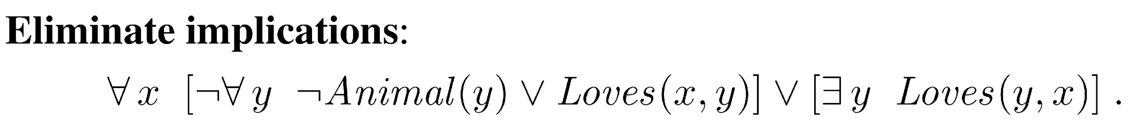
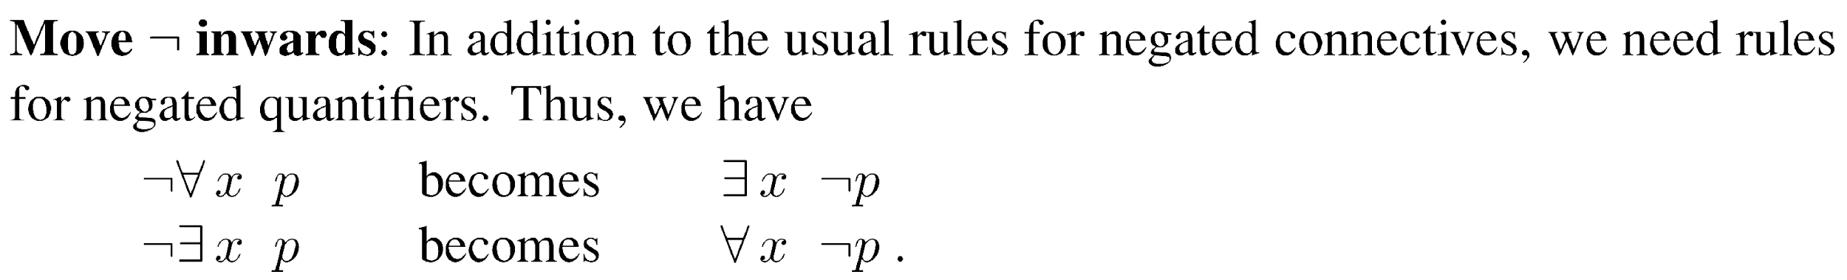
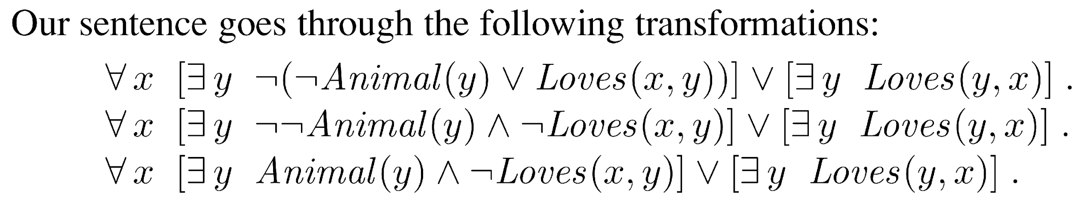
Conversion to CNF
Everyone who loves all animals is loved by someone

Slide 32
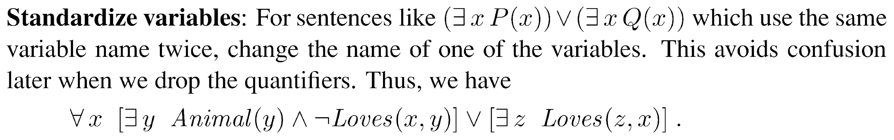
Conversion to CNF
Resolving existential instantiation: Each existential variable is replaced by a constant.
  ∀x [Animal(A) ∧ ¬Loves(x,A)] ∨ Loves(B,x)
Drop universal quantifiers:
  [Animal(A) ∧ ¬Loves(x,A)] ∨ Loves(B,x)
Distribute ∨ over ∧ :
  [Animal(A) ∨ Loves(A,x)] ∧ [¬Loves(x,A) ∨ Loves(B,x)]

Slide 33
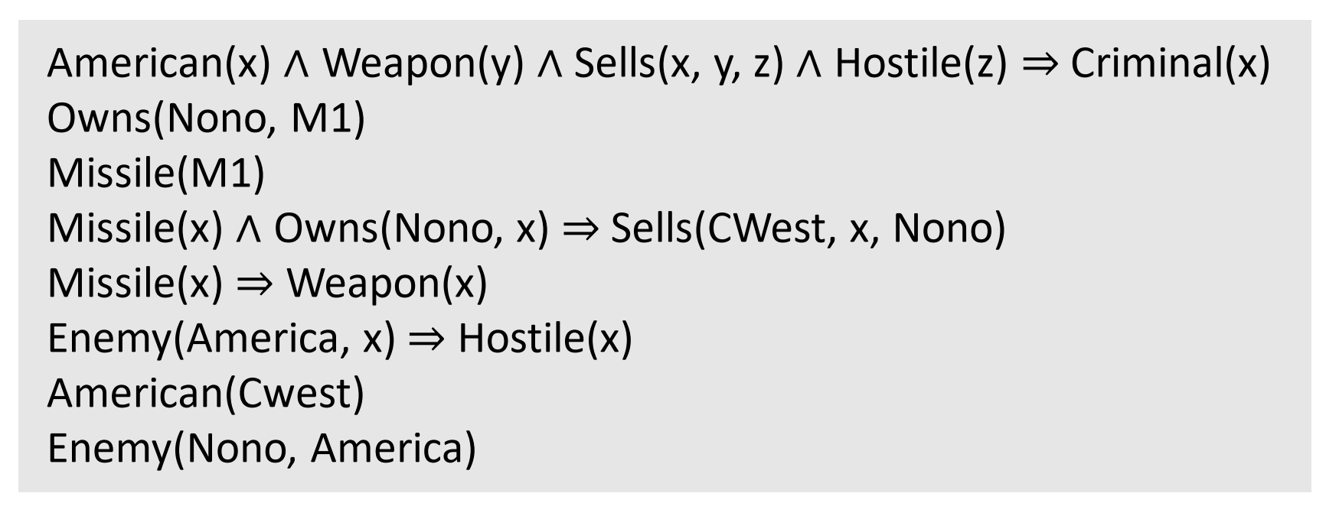
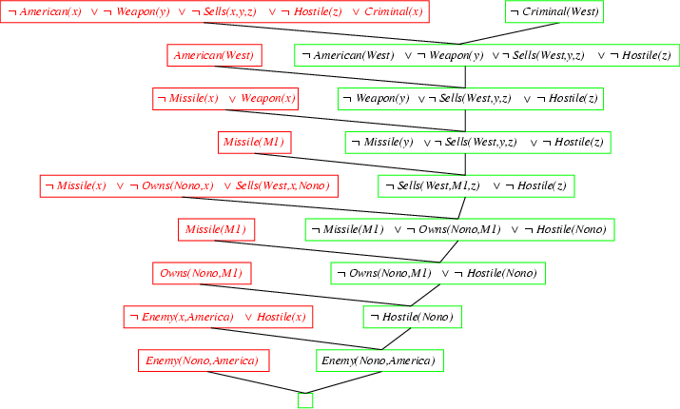
Resolution proof

Slide 34
References
Chapter 8, Artificial Intelligence, A Modern Approach, Third Edition, Stuart Russell and Peter Norvig

